Slide 1
Module 4 – Software Implementation
Sharon ONeal
sharononeal@email.arizona.edu
520-822-4040

Slide 2
Unit 1 – Introduction to Software Implementation (Coding)

Slide 3
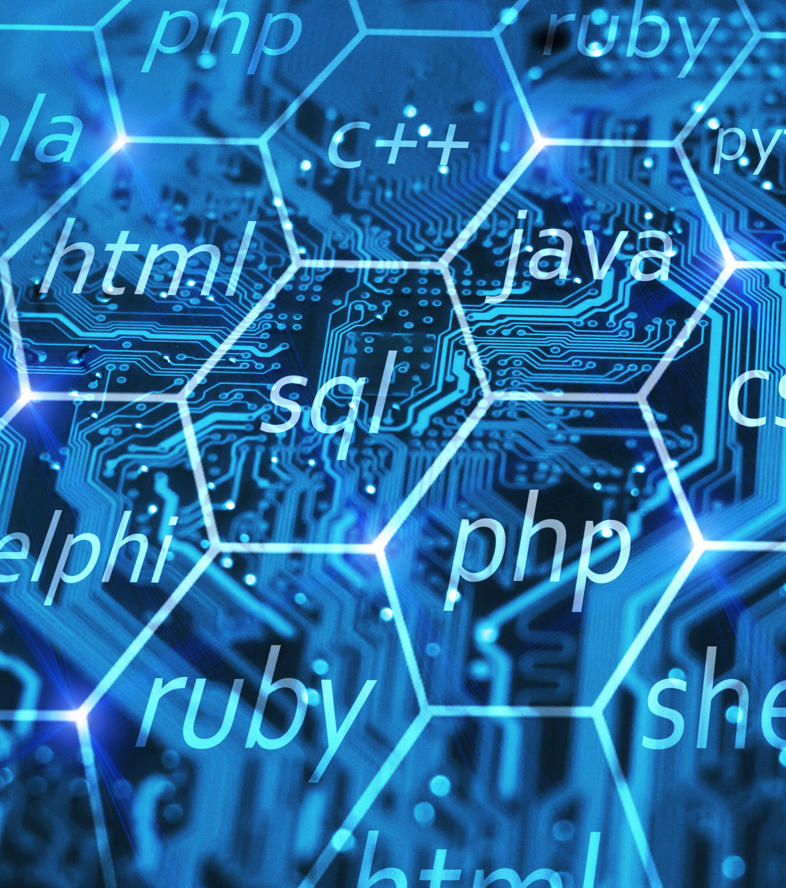
How Many Programming Languages Are There?
Some will say “too many”
More than 700 (according to Wikipedia)
Different languages are better suited to specific applications over others:
Real-time systems use C/C++
Hard real-time systems may even use Assembly language
Websites are often written in Javascript
Java is often used for mobile and web-based applications, GUIs, among others
Python is a great scripting language
R is typically used for statistical computing and graphics
Notes:
Wikipedia claims that there are approximately 700 different programming languages, while others say the number is much higher. The truth is, there have been countless programming languages created, some have come and gone, while new ones continue to be created. So why do we need so many different languages? In reality, we don’t. However, there are some languages that are better suited for certain types of programming applications. Some languages are interpreted languages such as HTML, Ruby, Perl, and Javascript. Programs written in these languages are executed within the interpreter itself and are platform independent. However, they tend to be slower. Compiled languages such as C / C++ generate native machine code that tends to execute faster than interpreted code. Some languages are both compiled and interpreted. For example, Python is compiled, but it is executed on its own Python virtual machine. Deciding which language to use for any given software development activity can often result in a series of trade studies that evaluates and scores different criteria that are important for the given application.

Slide 4
Some Basic Software Terminology
Terminology | Definition
Syntax | Set of rules and grammar that a computer can convert into executable statements
High Order Language | High level language that has a particular syntax more easily understood by humans
Assembly code | Low-level language specific to a given processor / microprocessor
Source code | File that contains the software written in any given language (HOL or Assembly)
Object code / Machine code | Code generated by a compiler or assembler. Multiple object files can be “linked” together to form the executable image.
Executable image | “Linked” code that is executed on the computer that is made up of 1s and 0s in a particular sequence that the computer understands
Debugger | Tool that is very useful in ensuring the correct execution and finding bugs in a software program

Slide 5
“Interpreted” Programming Languages
What is an “Interpreted language?
Definition: computer program that “interprets” and executes one line of source code at a time.
Features of an Interpreter:
Translates a computer program one statement at a time
Usually take less amount of time to analyze the source code since it is done one line at a time
Typically, slower execution time than code that is “compiled”
More efficient memory utilization since no object code is generated
Example interpreted languages: JavaScript, Python, R, Ruby

Slide 6
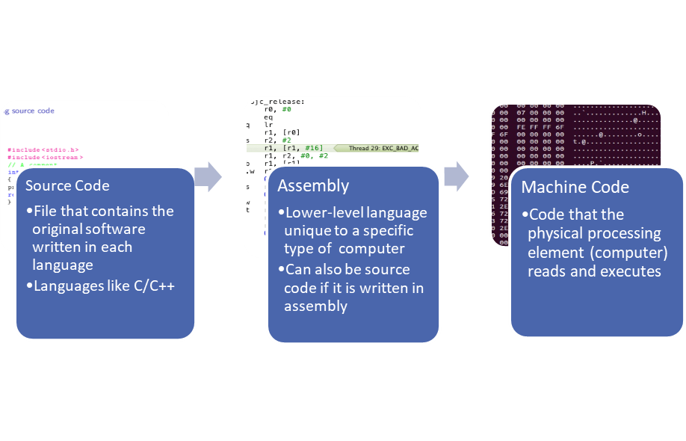
Compiled Programming Languages
What is a compiled Language?
Definition: Converts source code into executable code for a targeted computer
Features of a compiler:
Scans the entire program and translates it into object code
Usually takes longer to analyze a program since it evaluates the entire file of source code (not just one statement at a time)
Usually much faster execution time than interpreted code
Generates object code which is then “linked” with other object code modules so that it can be placed in memory
Programming languages like C / C++, and Java

Slide 7
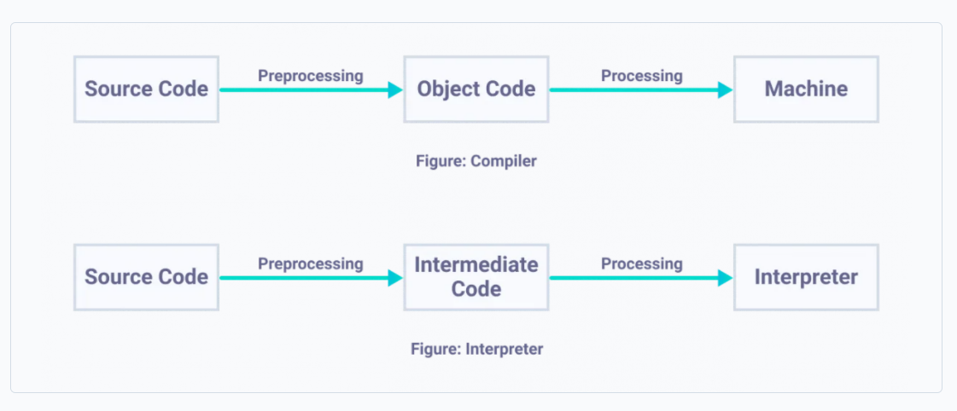
Difference Between Interpreter and Compilers
Compiler:
Executable generated for a target computer
Interpreter :
Computer program running on a host computer

Slide 8
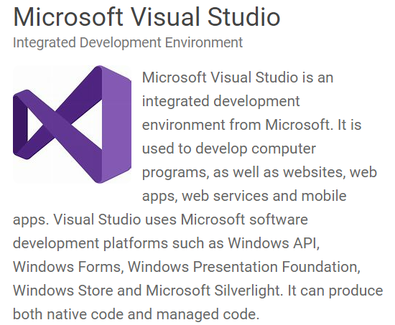
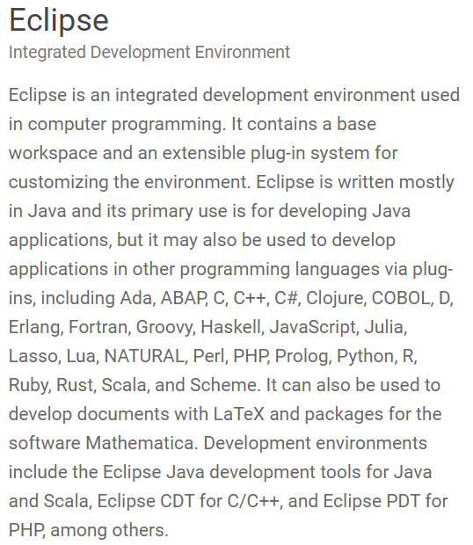
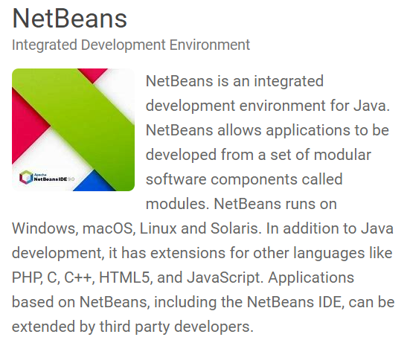
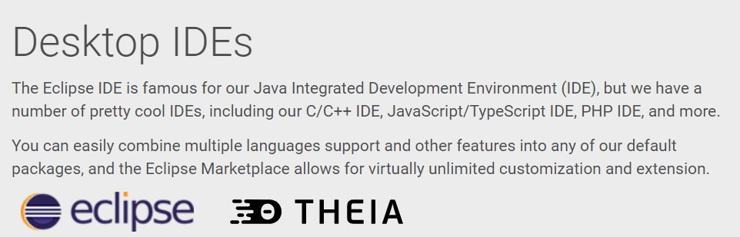
What is a Software Integrated Development Environment (IDE)?
Software application(s) that provides comprehensive facilities to develop and test software
Brings several development tools together in a cohesive package for software engineers
Usually consists of at least:
Source code editor
Build automation tools
Debugger
Some IDEs are web-based (Web IDE) hosted in an Online or Cloud environment

Slide 9
Let’s Practice….

Slide 10
Basic Programming Language Constructs (with a Python focus)
Variables / Data Types
Basic Statements
Looping Statements
Constants
Booleans
Integers
Floating point numbers
Strings
Lists
Dictionaries
Assignment statements
Print statements
If-then statements
If-then-else statements
“For” statements
“While loops”

Slide 11
Basic Programming Language Constructs (with a Python focus)
Classes
Functions
Modules
Object oriented programming
Object instantiation (or instances)
Inheritance
Attributes
Methods
Small segment of code that performs a specific set of actions and returns a value of a specified type
Small chunks of software that performs a given task or tasks
Comprised of classes, methods and variables in each program unit
Can be imported and reused multiple times without having to re-create it every time

Slide 12
Python3 Interpreter
SFWE 101 | Getting Started with Python
How to install a python interpreter on your computer
You can easily install a Python 3 interpreter on your computer
NOTE: Our zyBook already has a python interpreter integrated into the interactive book so it is not necessary until we get further along in the course and start working on the project
For a PC based computer: https://www.python.org/downloads/windows/
Be sure to download Python 3 release!!
For a macOS computer: https://www.python.org/downloads/macos/
Be sure to download Python 3 release!!

Slide 13
Let’s Practice….

Slide 14
Unit 2 – Overview of the Programming in Python 3 with zyLabs Interactive eBook

Slide 15
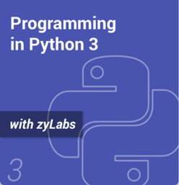
For the next several modules, we will be using this super cool interactive book to learn Python 3
Be sure that you have a copy of the Programming in Python 3 with zyLabs interactive book
Buy it directly from zyBooks
Sign in or create an account at learn.zybooks.com
Programming in Python 3 with zyLabs
Programming in Python 3 - zyBooks
Click on link found in the course “Start Here” content folder on D2L
Subscribe to the interactive book
Note: Each semester offering will have a different link to the zyBooks for that specific course. Be sure to use the link that is included in the “Start Here” module on your D2L course site

Slide 16
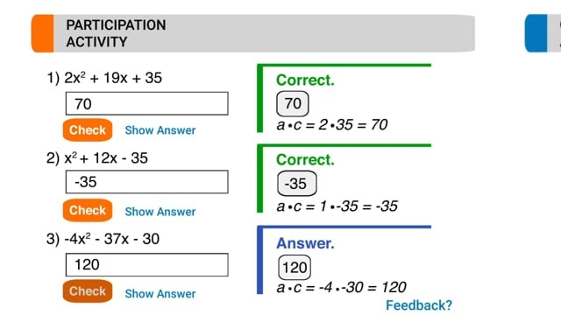
What is a zyBook? (For Students)

Slide 17
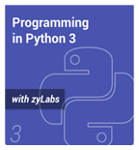
How to Access zyBooks Interactive Python 3 Textbook
SFWE 101 | How to Access Python with zylabs
zyBooks is a fun and interactive way to learn Python
Once you subscribe, the book should automatically appear in your zyBooks Library
For each module, we will cover specific chapters / sections in the interactive book
Your work will be recorded in D2L (this will be part of your course grade in the following areas:
Participation Activities= 15%
Homework assignments = 20%
At the beginning of each module, you will be instructed on the chapters/sections you are to complete
You can learn more about using zyBooks by reading the following tutorial pages:
https://learn.zybooks.com/zybook/HowToUseZyBooks2

Slide 18
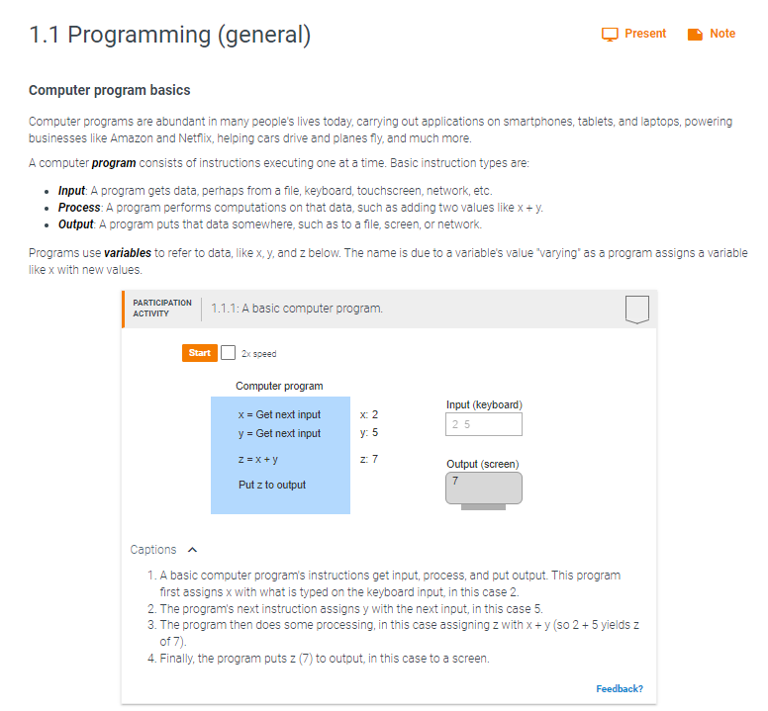
Let’s look at an example from the zyBooks interactive book
As shown in Programming in Python 3 with zyLabs

Slide 19
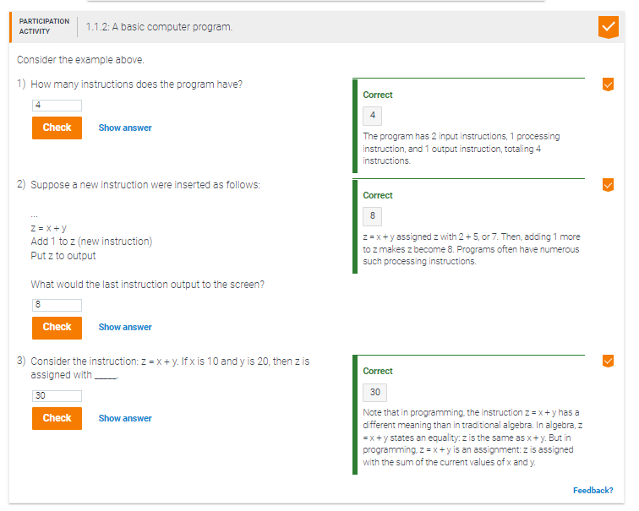
Using the program on the previous page….

Slide 20
Unit 3 “To Do List”: Complete the Following in the zyLabs Interactive Textbook

Slide 21
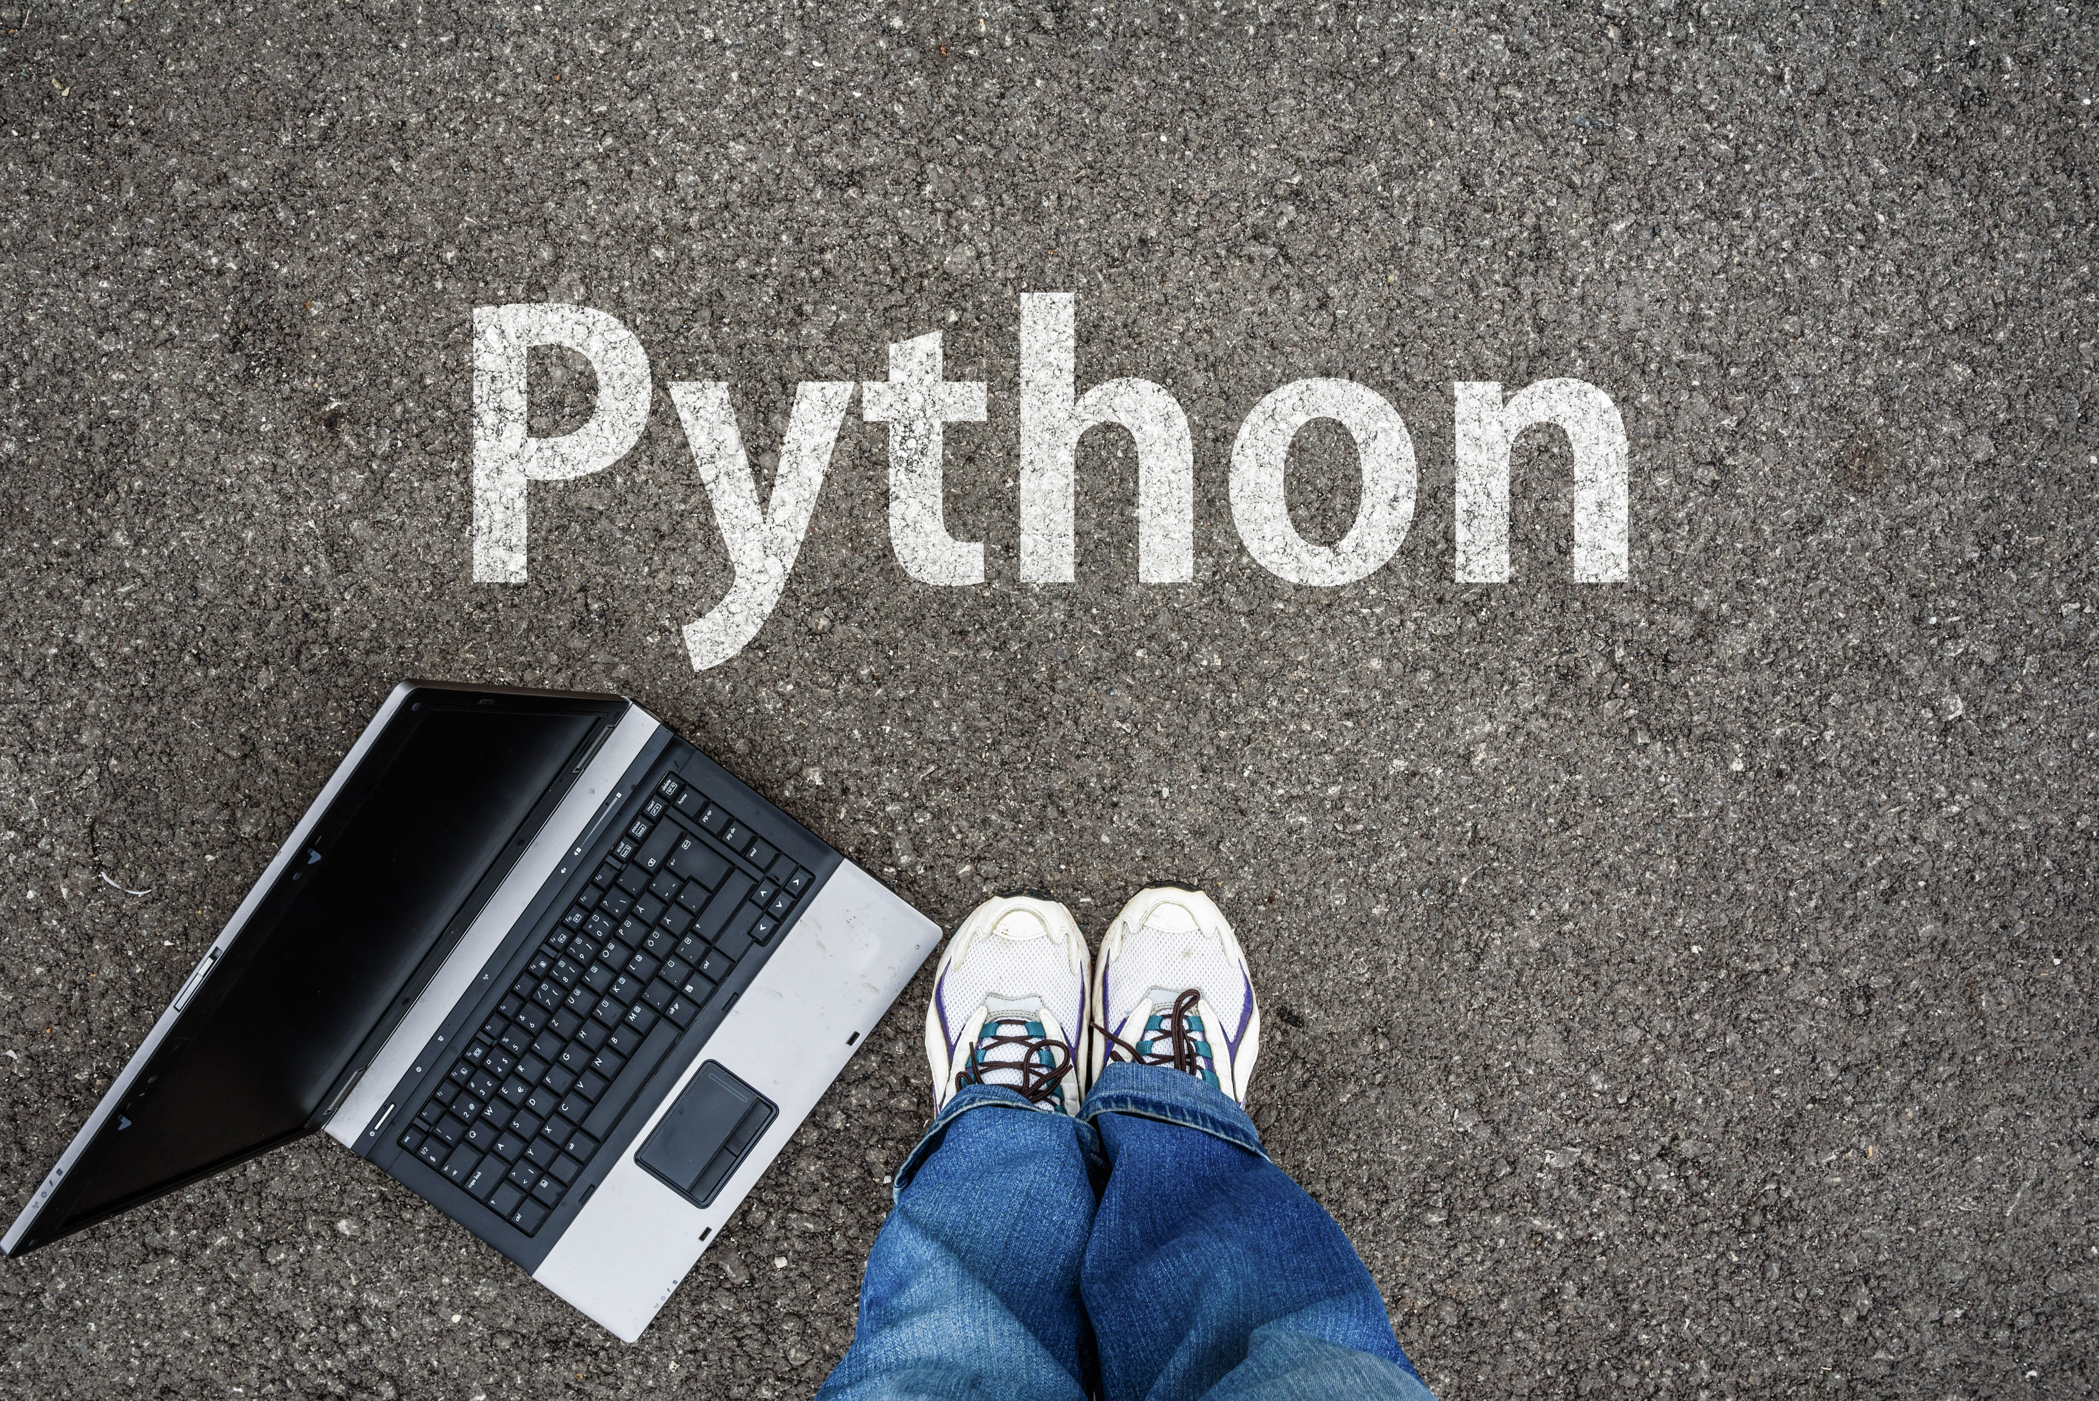
Read and Complete the Interactive Portions Shown to the Right
Read / Learn / practice:
Chapter 1 – Introduction to Python
1.1 Programming (general)
1.2 Programming using Python
1.3 Basic Input and Output
1.4 Errors
1.5 Development Environment
1.6 Computers and programs (general)
1.7 Computers tour
1.8 Language History
1.9 Why whitespace matters
1.10 Python example: Salary Calculation

Slide 22
Read and Complete the Interactive Portions Shown to the Right
Read / Learn / practice:
Chapter 2 – Variables and Expressions
2.1 Variables and assignments
2.2 Identifiers
2.3 Objects
2.4 Numeric Types: Floating-point
2.5 Arithmetic expressions
2.6 Python expressions
2.7 Division and modulo
2.8 Module basics
2.9 Math module
2.10 Representing text

Slide 23
Read and Complete the Interactive Portions Shown to the Right
Read / Learn / practice:
Chapter 3 – Types
3.1 Programming (general)
3.2 Programming using Python
3.3 Basic Input and Output
3.4 Errors
3.5 Development Environment
3.6 Computers and programs (general)
3.7 Computers tour
3.8 Language History
3.9 Why whitespace matters
3.10 Python example: Salary Calculation

Slide 24

Complete the Following Labs in Chapters 1 - 3
The following are to help you get familiar with how the labs work:
1.11 zyLab training: Basics
1.12 zyLab training: Interleaved input / output The following are actual zyLabs LABS associated with each chapter of the book:
1.13 LAB: Formatted output: Hello World!
2.11 LAB: Divide by x
2.12 LAB: Expression for calories burned during workout
3.10 LAB: Input and formatted output: Right facing arrow

Slide 25
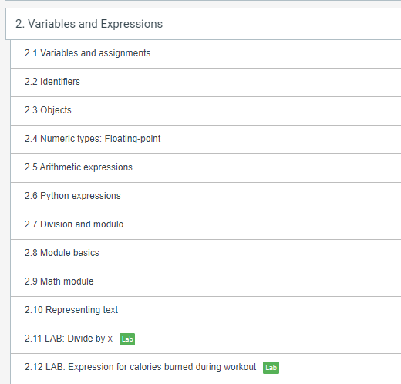
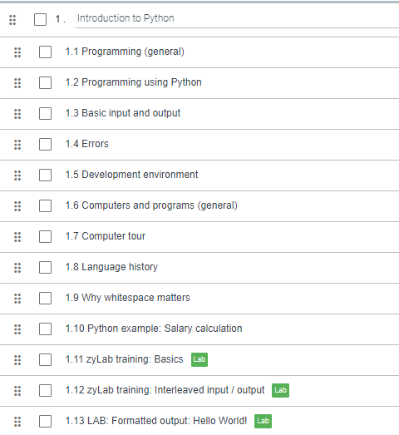
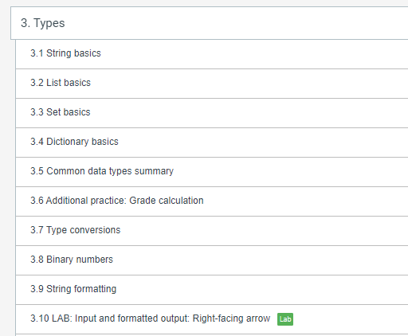
In Summary: Your zyBooks Assignment for Module 4

Slide 26
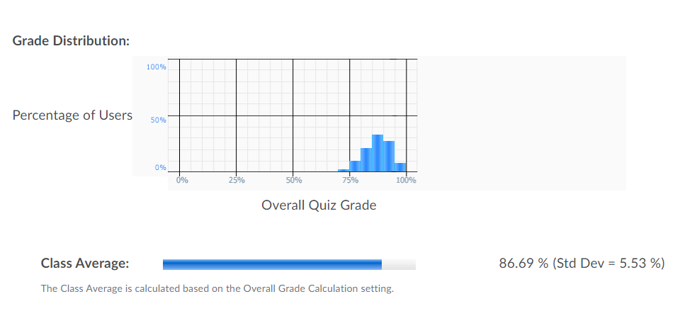
Grade Distribution for all 3 sections (001, 002, 025)

Slide 27
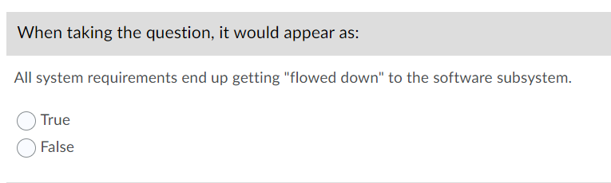
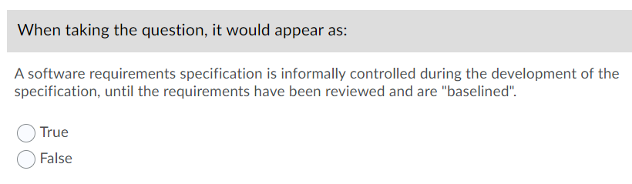
Questions that seemed to cause problems
What are the correct answers?

Slide 28
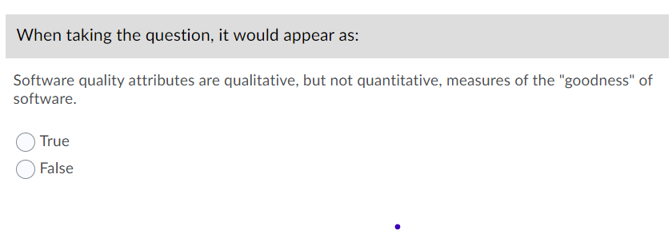
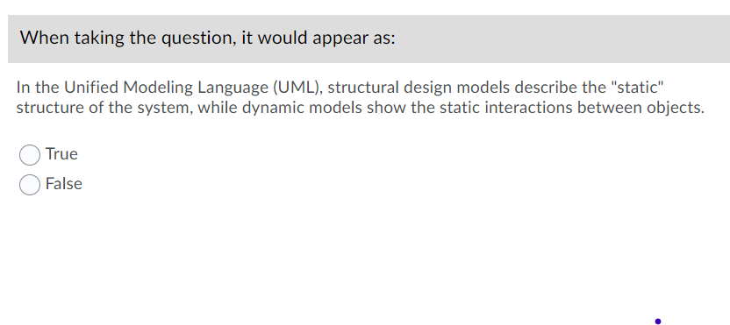
Questions that seemed to cause problems
What are the correct answers?

Slide 29
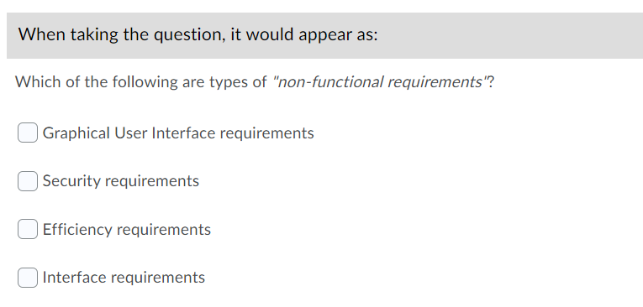
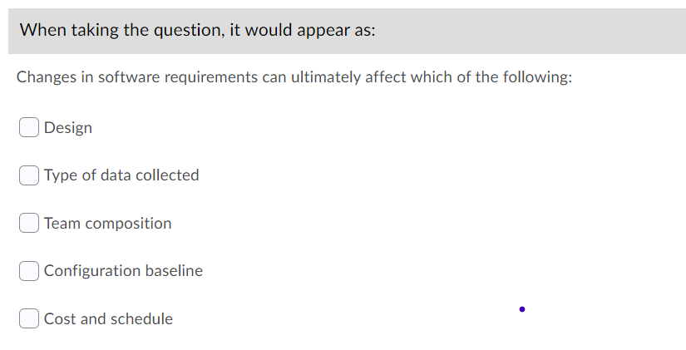
Questions that seemed to cause problems
What are the correct answers?

Slide 30
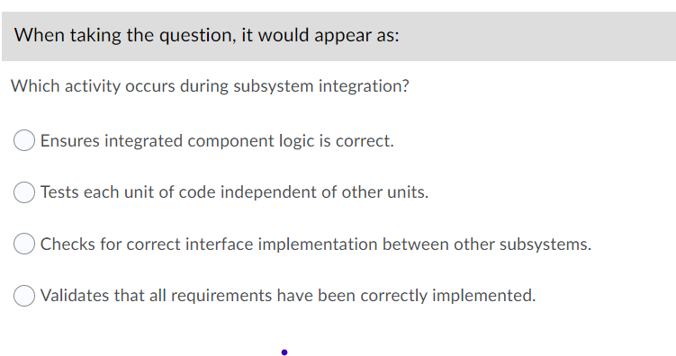
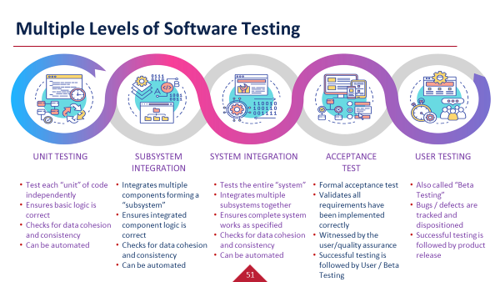
Questions that seemed to cause problems
What are the correct answers?

Slide 31
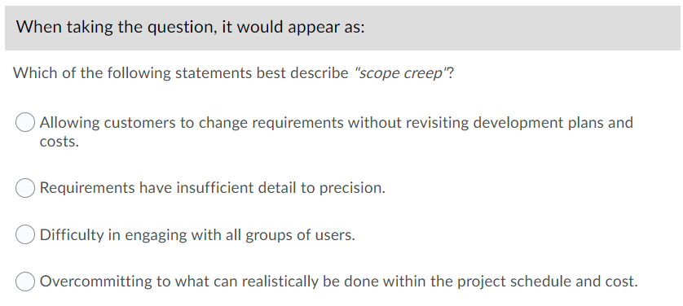
Questions that seemed to cause problems
What are the correct answers?

Slide 32
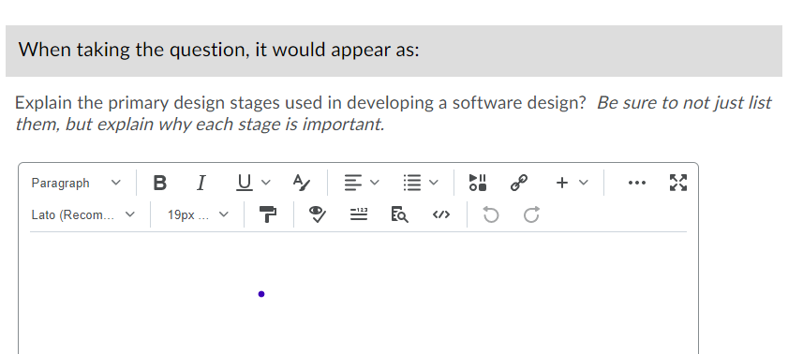
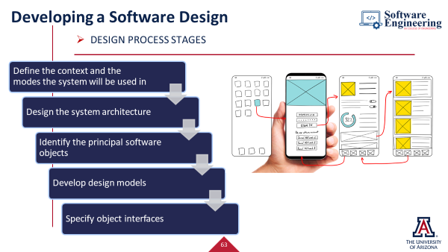
Questions that seemed to cause problems
What are the correct answers?

Slide 33
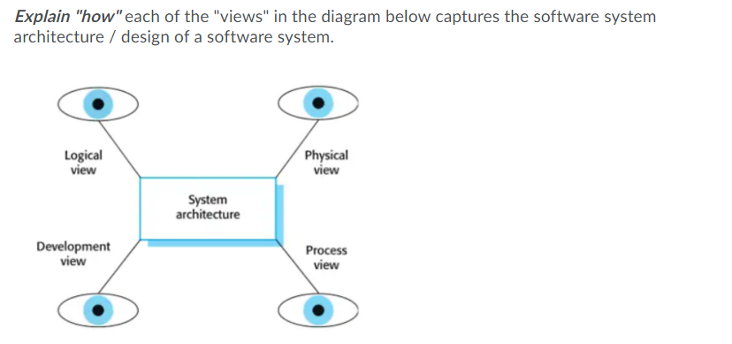
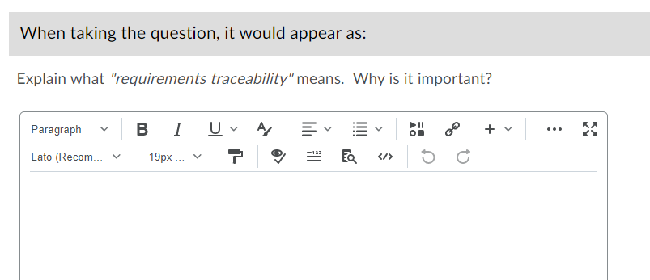
Questions that seemed to cause problems
What are the correct answers?

Slide 34
Cadence of working thru zyBooks Chapters 1-4

Slide 35
Time to Jump to zyBooks – Chapter 2

Slide 36
Variables and Expressions
Section 2.1 Variables and Assignments
zyBooks Lab – in class activities
What is a variable?
What is an expression?
Which are valid assignment statements?
Participation 2.1.3
Write the code for Assigning a sum
Challenge Activity 2.1.2

Slide 37
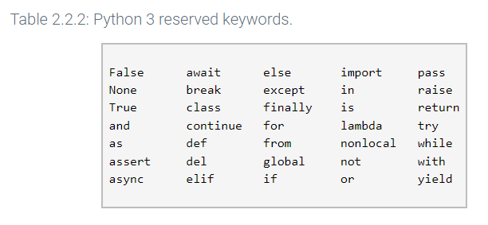
Variables and Expressions
2.2 Identifiers
What is an identifier?
Can an identifier start with an underscore?
Is python case sensitive?
What are “reserved words” or “keywords”
What are some examples of reserved words or keywords in Python?
Zybooks in class activities

Slide 38
Variables and Expressions
2.3 Objects
What is an “object”?
Does the Python interpreter or the programmer generate objects?
Participation Activity 2.3.1
What does the term “garbage collection” mean?
What is name binding?
Participation Activity 2.3.2
What are the 3 properties of a Python object?
value, type, identity (what does identity refer to?)
What does the Python function type() do?
What does the Python function id() do?
zyDE 2.3.1
Zybooks in class activities

Slide 39
Variables and Expressions
2.4 Numeric Types: Floating-point
What is a float-type object?
What is the range of a floating-point object when you have a 32-bit installation of Python?
What is an OverflowError?
Why do we have to be careful of Overflow errors?
When should you use the float type?
When should you use the integer type?
Participation activity 2.4.2
What does the following statement mean?
print(f'{myFloat:.2f}’)
Participation Activity 2.4.4
Zybooks in class activities

Slide 40
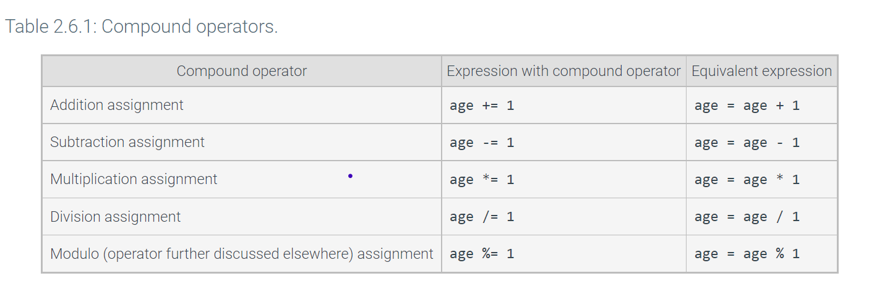
Variables and Expressions
2.5 Arithmetic Expressions
What is a unary minus?
Why is it good practice to put a “space” around “operators”
What is a compound operator?
Are commas allowed in integer or float literals?
Zybooks in class activities

Slide 41
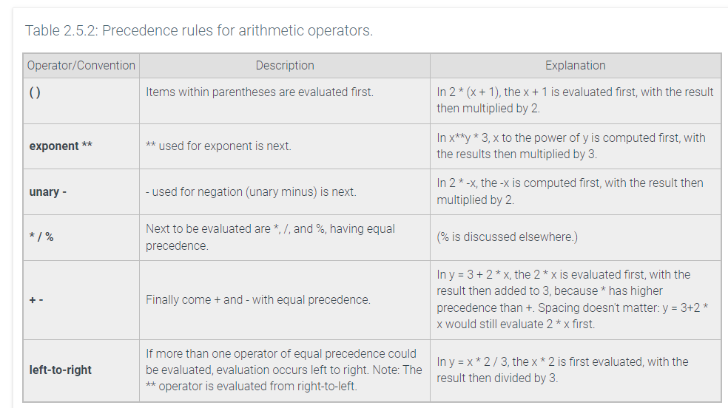
Variables and Expressions
2.5 Arithmetic expressions
Zybooks in class activities
Participation Activity 2.5.1
Participation Activity 2.5.2

Slide 42
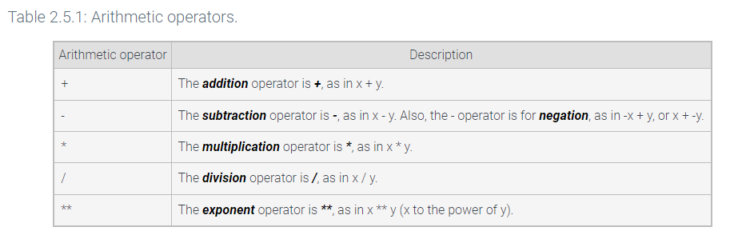
Variables and Expressions
2.6 python Expressions
What is a literal?
What is an operator?
What is an expression in Python?
Zybooks in class activities

Slide 43
Variables and Expressions
2.6 python expressions
Zybooks in class activities
Challenge Activity 2.6.1
Challenge Activity 2.6.2
Challenge Activity 2.6.3

Slide 44
Variables and Expressions
2.7 Division and modulo
Zybooks in class activities
What type does the division operator return?
What is the value returned by 5/10?
What is a floored division operator?
What is the value returned by 5//10?
Can you divide by 0 in python?
What symbol is used to denote the “modulo” operation?
What is the value of 24 % 10?
Participation Activity 2.7.3

Slide 45
Variables and Expressions
2.8 Module basics
Zybooks in class activities
What is a script?
How do you invoke a script?
When does the script get executed?
What is a module?
How do you reference code that is in another module?
How do you reference an object that is referenced in an imported module?
Participation Activity 2.8.2

Slide 46
Variables and Expressions
2.8 Module basics
Zybooks in class activities
When does the imported module get executed?
What does the built-in special name “__name__” do?
Who can explain Figure 2.8.1?
Participation Activity 2.8.4

Slide 47
Variables and Expressions
2.9 Math Module
Zybooks in class activities
What is the math module?
How do you use/invoke the math module?
What is a function?
What is an argument to a function?
How do you make a function call?

Slide 48
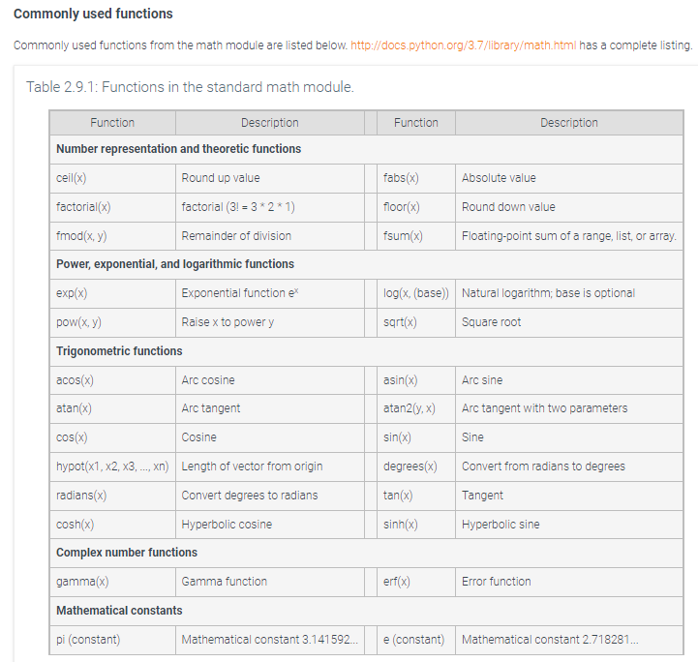
Variables & Expressions
2.9 Math Module
Participation 2.9.1
Challenge Activity 2.9.3

Slide 49
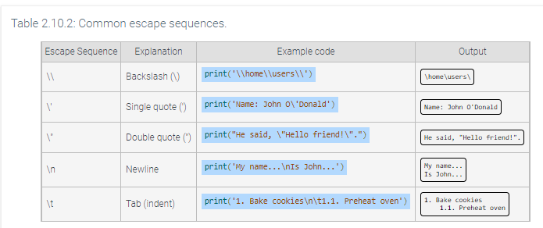
Variables and Expressions
2.10 Representing text
What is Unicode?
What is code point?
See Table 2.10.1 in the book
What is an escape sequence?
Participation Activity 2.10.2
What is a raw string
What does the function ord() return?
What does the function chr() return?
Zybooks in class activities

Slide 50
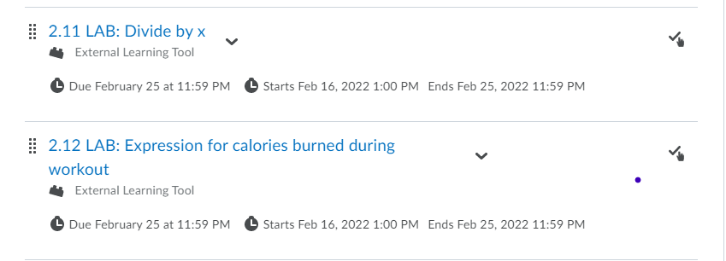
Variables & Expressions – Labs 2.11 & 2.12 due by 2/25 at midnight
Be sure to SUBMIT the lab after you are done with development!!

Slide 51

A Fun Way to Interact and Apply What You’ve Read / Learned

Slide 52
Chapter 3 - Types
3.1 String Basics
Zybooks in class activities
What is a sequence type? Is a string = sequence type?
What is the first character indexed with?
What is the notation for an empty string?
What does the \ character at the end of string signify?
What does the built-in function len() do?
Participation 3.1.4
What does string indexing mean?
Participation 3.1.5

Slide 53
Chapter 3 - Types
3.1 String Basics
Zybooks in class activities
What does the phrase “strings are immutable” mean?
How do you update a string?
How do you concatenate a string with another string?
Participation 3.1.6

Slide 54
Chapter 3 - Types
3.2 list Basics
Zybooks in class activities
What is a container?
What is a list? How is a list designated in Python?
What is an element in Python?
How is an element referenced in Python?
What is the 1st element in a list indexed?
Participation activity 3.2.2
How do you update a list element?
Participation activity 3.2.5
Are lists mutable or immutable? What does it mean?

Slide 55
Chapter 3 - Types
3.2 list Basics
Zybooks in class activities
What does append() do?
What does pop() do?
How do you write the statement to pop the 3rd element from my_list?
What does remove () do?
How do you write the statement to remove the letters ‘abc’ from my_list? Where my_list = [10, ‘abc’, 25]
my_list.remove(‘abc’)
Discuss the sequence type functions in Table 3.2.1

Slide 56
Chapter 3 - Types
3.3 set Basics
Zybooks in class activities
What is the set type?
What 2 properties do sets have?
Elements are unordered (they do not have a position or index)
Elements are unique (no elements in the set share the same value)
How do you create a set in Python?
What is another way to create a set in Python?
nums1 = set([1, 2, 3])
nums2 = {7, 8, 9}
What does num2[2] return?
Why might we want to use the set type?
Participation Activity 3.3.1

Slide 57
Chapter 3 - Types
3.3 set Basics
Zybooks in class activities
What does the method add() do?
What does the method remove() do?
What does the method pop() do?
Discuss the different methods that can be performed on sets in Table 3.3.1
What are common set theory operations?
Review common set theory operations in Table 3.3.2
Participation activity 3.3.5

Slide 58
Chapter 3 - Types
3.4 dictionary Basics
What is a Python dictionary type?
Represented by the dict object type
Associates (or maps) keys with values -> key:value pairs
Example: players = {‘Lionel Messi’ : 10, ‘Cristiano Ronaldo’: 7}
Participation 3.4.1
Can dictionary entries be accessed by indexing?
How are dictionary entries accessed?
What is the Python syntax to access a dictionary entry?
prices = {‘apples’: 1.99, ‘oranges’: 1.49}
How do you access the price of an apple?
What is a KeyError?
Zybooks in class activities

Slide 59
Chapter 3 - Types
3.4 dictionary Basics
Zybooks in class activities
Can dictionary entries be added, modified, or deleted?
Refer to the discussion on how to add, modify or delete an item from a dictionary
Participation Activity 3.4.3
Give an example of when you might want to use the dictionary type?

Slide 60
Chapter 3 - Types
3.5 Types summary
Zybooks in class activities
Name 2 types of numeric Python types
Give 2 examples of sequence types that we have discussed
String, list
Are sequence types indexed? What position does the first index start with?
What types can lists contain?
What types can a string contain?
What is a mapping type in Python?
How are elements in a Python dict type indexed?

Slide 61
Chapter 3 - Types
3.5 types summary
Zybooks in class activities
Participation Activity 3.5.1
Participation Activity 3.5.2
Participation Activity 3.5.3

Slide 62
Variables & Expressions – Labs 2.11 & 2.12 due by 2/25 at midnight
Be sure to SUBMIT the lab after you are done with development!!

Slide 63
Wrapping Up Module 4

Slide 64
Chapter 3 - Types
3.6 Grade Calculation
Zybooks in class activities
Let’s walk thru the Grade calculator as given in zyDE 3.6.1
Working in your table group, complete exercise 1 (4-5 minutes)
Need a volunteer to share their work with the class
Working in your table group, complete exercise 2 (4-5 minutes)
Need a volunteer to share their work with the class
Working in your table group, complete exercise 3 (4-5 minutes)
Need a volunteer to share their work with the class

Slide 65
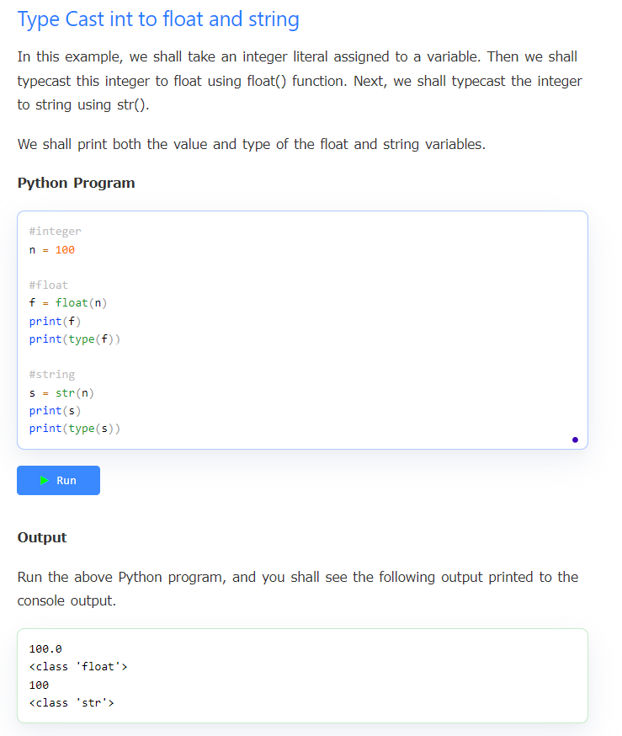
Chapter 3 - Types
3.7 type conversions
Zybooks in class activities
Participation Activity 3.7.2
What is type casting?

Slide 66
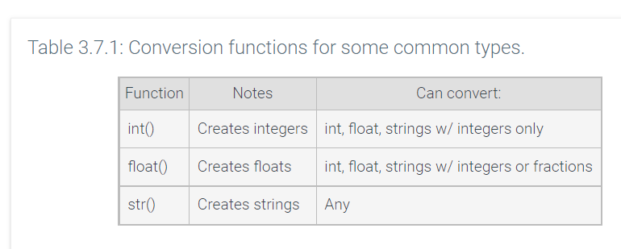
Chapter 3 - Types
3.7 Type conversions
Zybooks in class activities
What does the term type conversion mean?
What is an implicit conversion?
Participation Activity 3.7.1
What is an explicit conversion and when might we want to do this?

Slide 67
Chapter 3 - Types
3.7 type conversions
Zybooks in class activities
Participation Activity 3.7.2
What is type casting?
Challenge Activity 3.7.3

Slide 68
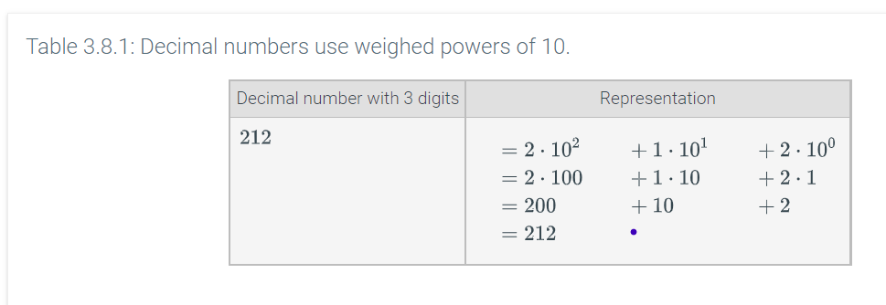
Chapter 3 - Types
3.8 binary numbers
Zybooks in class activities
What ‘base’ does the average programmer / person use to refer to numbers?
What ‘base’ does a computer use?
What is a binary number?
What is the typical size (in number of bits) of a Python variable?

Slide 69
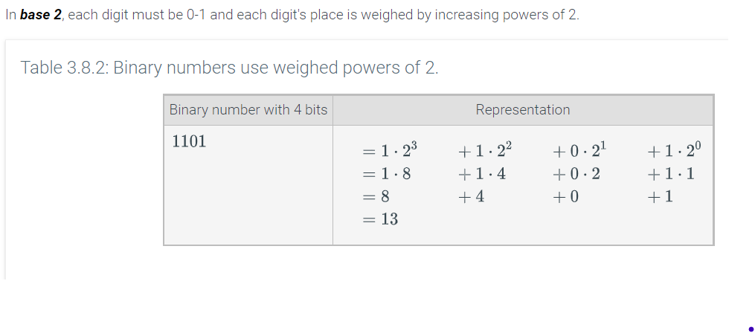
Chapter 3 - Types
3.8 binary numbers
Zybooks in class activities
Participation Activity 3.8.1
Participation Activity 3.8.2

Slide 70
Chapter 3 - Types
3.9 string formatting
What is a formatted string literal?
How is a formatted string literal denoted in Python?
An f-string starts with a ‘f’ character before the starting quote and uses curly braces {} to denote the placeholder expression
See Participation Activity 3.9.1
Participation Activity 3.9.2
Discuss the “Additional f-string features” section of the book
Participation Activity 3.9.3
What is a format specification?
What is a presentation type?
Review Table 3.9.2
Participation Activity 3.9.4
Zybooks in class activities

Slide 71
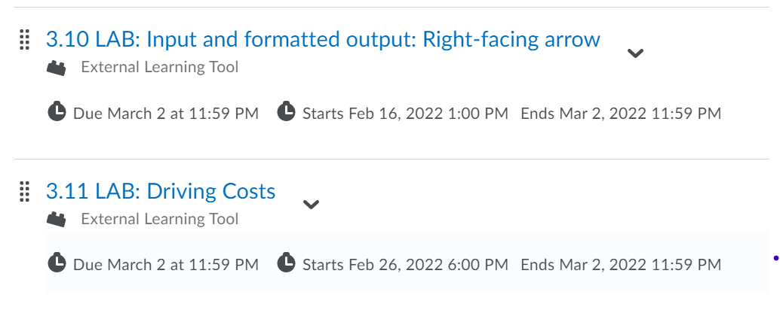
Chapter 3 - Types
Labs 3.10 and 3.11
Zybooks in class activities
We are starting Module 5 on Wed, 3/2!!!
Get all the Participation Activities in Chapters 1, 2, 3 completed by midnight 3/1

